Slide 1

Node.js Security
Best Practices
Tre’ Grisby
@Trewaters
Government IT Professional
@JavaScriptDojo
November 2018

Slide 2
Tre’ Grisby contact information
TALKING POINTS
Please save questions until the end
What version is Node.js LTS?
What is the latest version of npm?
Node.js is part of an ecosystem
Twitter ( @trewaters )
LinkedIn ( linkedin.com/in/trewaters )
Monthly Meetup “Berkeley JavaScript Dojo” ( meetup.com/Berkeley-Javascript-Dojo )
Google+ ( plus.google.com/+TreGrisby )
Notes:
About me…
Name
Where I am active
Where I work
Work history (Government infrastructure, Jack of all trades)
What I love Security, helping others, JavaScript and its community. Anything new and shiny. Roleplaying games like Shadowrun or Dungeons & Dragons, Skateboards, Digital Cash like (bitcoin, Dash, Pivx). Online conventions

Slide 3

OWASP
The “Open Web Application Security”
List Top 10 Application Security Risks
November 5th is next meetup

Slide 4




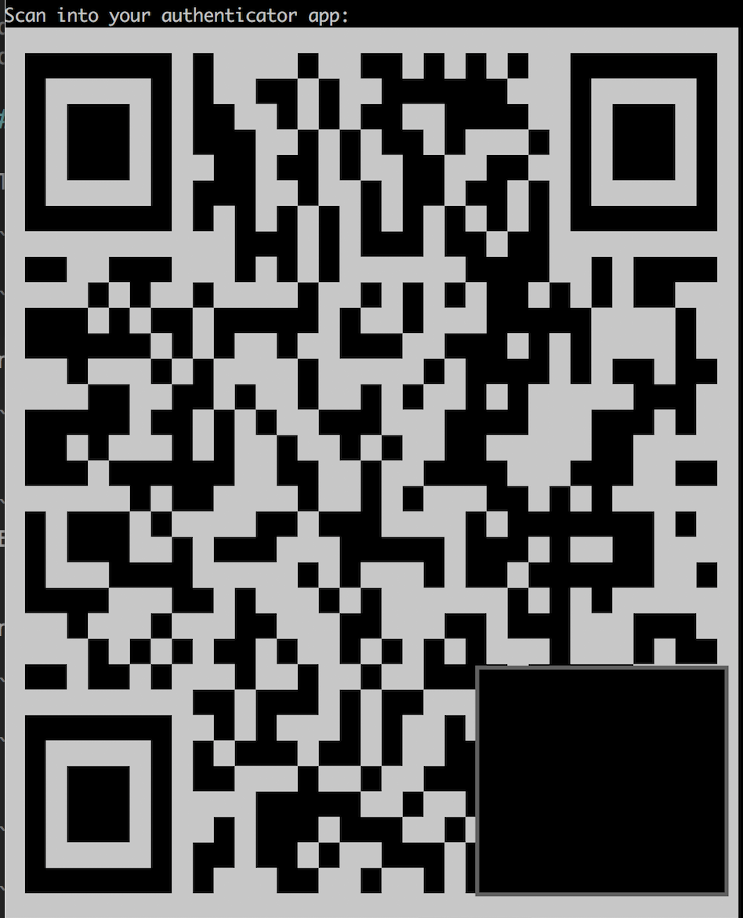


Node packet manager
Security Audits, available in npm v6
Two-Factor Authentication ( 2fa )
One Time Password ( OTP ), Authy or Google Authenticator
Recover your 2fa and OTP
Yarn should work too for 2fa
npm-che

Slide 5
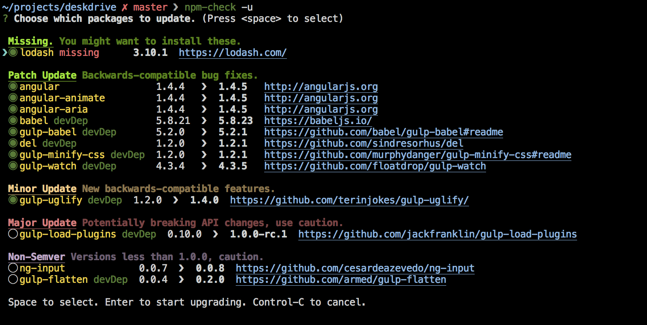
npm-check
Check for outdated, incorrect, and unused dependencies
Research your changes

Slide 6

Linter Security Rules
TSLint
Unsafe regexp
Non literal buffer
Buffer noassert
Child process
Disable mustache escape
Eval with expression
No csrf before method override
Non literal fs filename
Non literal regexp
Non literal require
Possible timing attacks
Pseudo random bytes
Html injection
SQL literal injection
ESLint
Unsafe regex
Buffer noassert
Child process
Disable mustache escape
Eval with expression
Csrf before method override
Non literal fs filename
Non literal regexp
Non literal require
Object injection
Possible timing attacks
PseudoRandomBytes

Slide 7
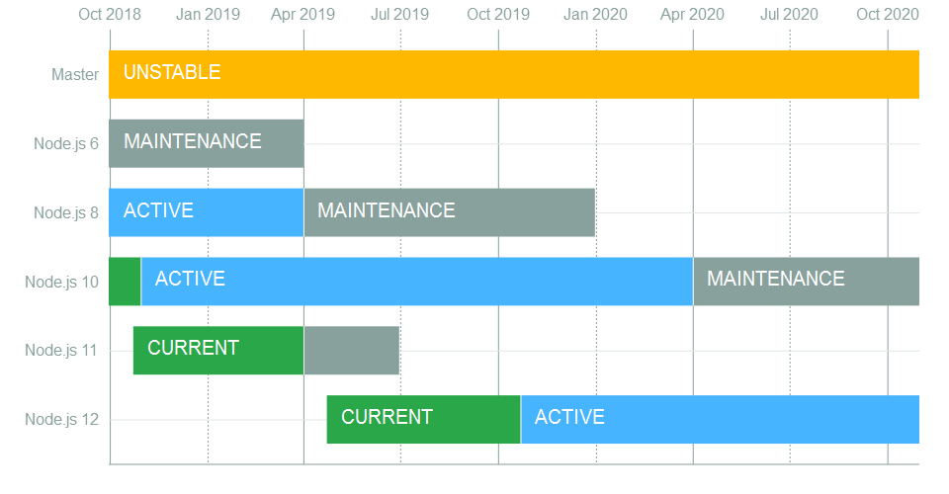
Security Patches
Use the even versions of Node.js for enterprise applications… please
Release Working Group
Current, Active, Maintenance
Long Term Support ( LTS )
3 years from Current to EOL
End of Life ( EOL )
bump dependency versions, if you can
Track updates with SemVer
Notes:
Node 6.x EOL scheduled for April 2019
Node 10.x EOL scheduled for April 2021
Node 11.x EOL scheduled for June 2019
- LTS gets Bug fixes, security updates, non-semver-major npm updates
Do not use EOL versions they are no longer getting security updates or patches
SemVer

Slide 8
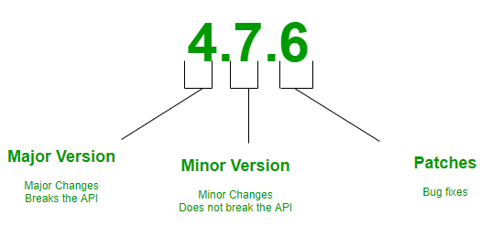
Semantic Versioning ( Semver )
Major.Minor.Patch
Notes:
Given a version number MAJOR.MINOR.PATCH, increment the:
- MAJOR version when you make incompatible API changes,
- MINOR version when you add functionality in a backwards-compatible manner, and
- PATCH version when you make backwards-compatible bug fixes.
Additional labels for pre-release and build metadata are available as extensions to the MAJOR.MINOR.PATCH format.

Slide 9
OWASP Top 10 Threats
Injection
Broken Authentication
Sensitive Data Exposure
XML External Entities (XXE)
Broken Access Control
Security Misconfiguration
Cross-Site Scripting (XSS)
Insecure Deserialization
Using Components with Known Vulnerabilities
Insufficient Logging & Monitoring

Slide 10
OWASP Top 10 Threats
1) Injection

Slide 11
OWASP Top 10 Threats
2) Broken Authentication

Slide 12
OWASP Top 10 Threats
3) Sensitive Data Exposure

Slide 13
OWASP Top 10 Threats
4) XML External Entities (XXE)

Slide 14
OWASP Top 10 Threats
5) Broken Access Control

Slide 15
OWASP Top 10 Threats
6) Security Misconfiguration

Slide 16
OWASP Top 10 Threats
7) Cross-Site Scripting (XSS)

Slide 17
OWASP Top 10 Threats
8) Insecure Deserialization

Slide 18
OWASP Top 10 Threats
9) Using Components with Known Vulnerabilities

Slide 19

OWASP Top 10 Threats
10) Insufficient Logging & Monitoring
Notes:
Don’t be the one with video cameras that no one is watching or setting to record.

Slide 20
Threats in the wild
Electron was exploited. You should be using version 2 or higher
Reverse Shell attack through using `eval`
Common Vulnerabilities and Exposure (CVE)

Slide 21
NodeGoat
App you can deploy on Heroku and check for exploits.
Has a guide on ways to fix the vulnerabilities
github.com/OWASP/NodeGoat

Slide 22
Disclose Node.js vulnerabilities
Report issues:
email ( security@nodejs.org )
website ( hackerone.com/node.js )
more information here ( nodejs.org/en/security )
Add a `Security.md` file to your repo with how developers should report issues to you.
( github.com/securitytxt/security-txt )
Notes:
There are bug bounties too

Slide 23
acknowledgements
i0natan
( https://github.com/i0natan/nodebestpractices/tree/security-best-practices-section/sections/security )
Thomas Hunter II
( https://medium.com/intrinsic/common-node-js-attack-vectors-the-dangers-of-malicious-modules-863ae949e7e8 )
Notes:
There are bug bounties too

Slide 24
The End… Done…
GitHub ( https://github.com/Trewaters/SFNode_November_2018 )

